Slide 1
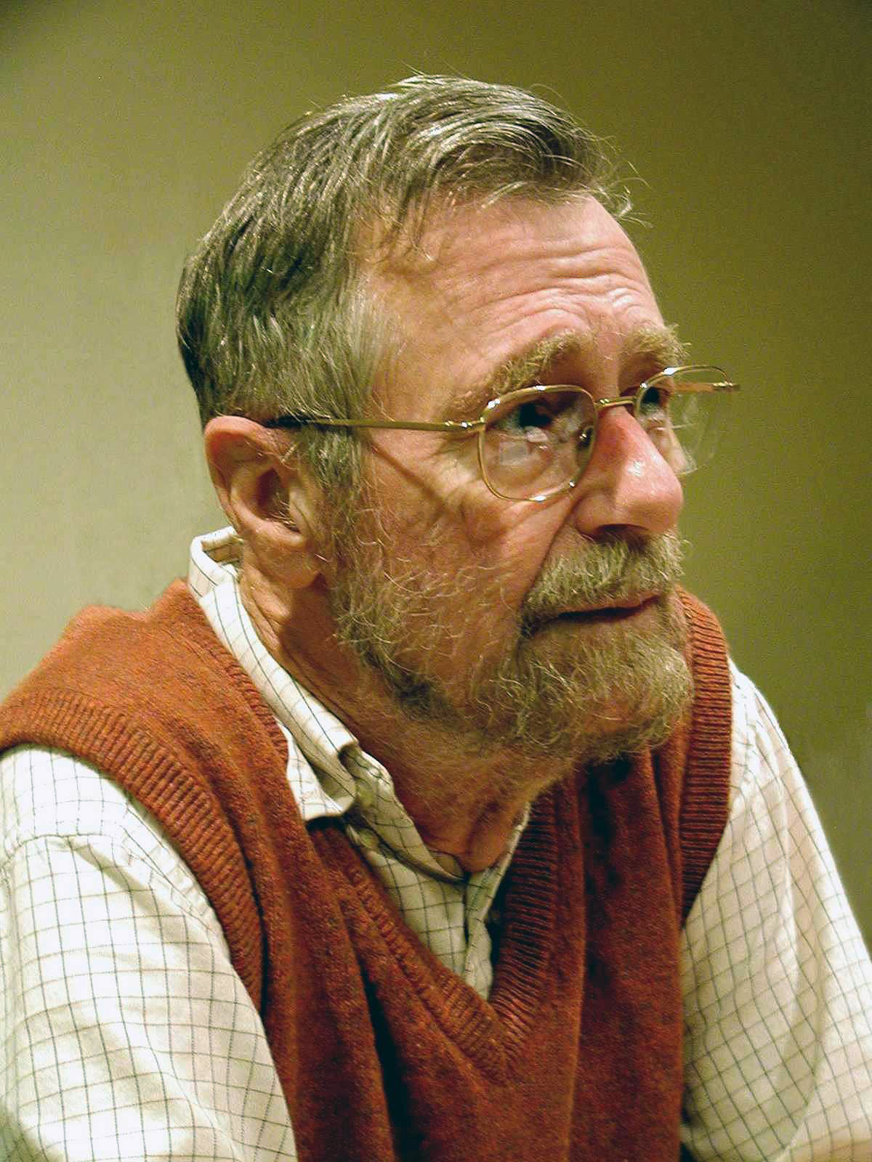
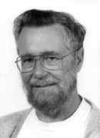
DIJKSTRA’S
Algorithm for finding shortest path
Edsger Dijkstra (born May 11, 1930, Rotterdam, Netherlands—died August 6, 2002, Nuenen) was a Dutch computer scientist who developed the paradigm of structured programming for writing computer program.
Dijkstra received a Ph.D. from the University of Amsterdam in 1959 while working at Amsterdam’s Mathematical Center (1952–62). He taught at the Technical University of Eindhoven from 1963 to 1973.
He developed the shortest path algorithm, a method for finding the most direct route between two points in a network.

Slide 2
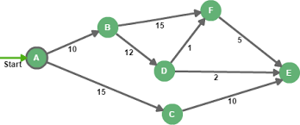
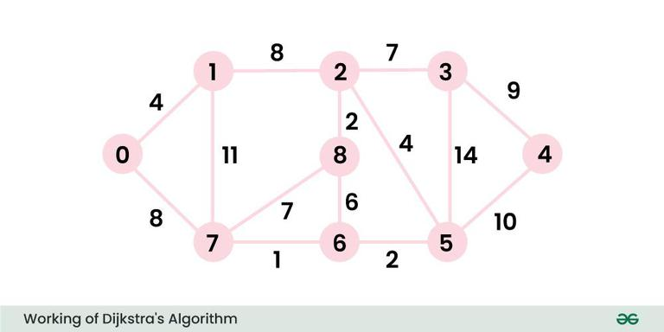
Edsger Dijkstra (born May 11, 1930, Rotterdam, Netherlands—died August 6, 2002, Nuenen) was a Dutch computer scientist who developed the paradigm of structured programming for writing computer program.
Dijkstra received a Ph.D. from the University of Amsterdam in 1959 while working at Amsterdam’s Mathematical Center (1952–62). He taught at the Technical University of Eindhoven from 1963 to 1973.
He developed the shortest path algorithm, a method for finding the most direct route between two points in a network.
Concept
Dijkstra's algorithm starts by setting initial distances for all vertices in the graph. It then chooses the unvisited vertex with the shortest distance from the starting vertex as the current vertex. The algorithm continues in this way, creating a tree of shortest paths from the starting vertex to all other points in the graph.
Example:
Output: 0 4 12 19 21 11 9 8 14 Explanation: The distance from 0 to 1 = 4. The minimum distance from 0 to 2 = 12. 0->1->2 The minimum distance from 0 to 3 = 19. 0->1->2->3 The minimum distance from 0 to 4 = 21. 0->7->6->5->4 The minimum distance from 0 to 5 = 11. 0->7->6->5 The minimum distance from 0 to 6 = 9. 0->7->6 The minimum distance from 0 to 7 = 8. 0->7 The minimum distance from 0 to 8 = 14. 0->1->2->8

Slide 3
Graph Representation: The graph is typically represented as a set of vertices (nodes) connected by edges (paths). Each edge has a non-negative weight (cost) representing the distance between the two connected nodes.
Single Source Shortest Path: The goal is to determine the shortest distance from a given source vertex to all other vertices in the graph.
Priority Queue (Min-Heap): Dijkstra’s algorithm relies on a priority queue to select the next node with the smallest distance. This queue ensures that the algorithm explores nodes with the shortest known distance first, avoiding unnecessary calculations.
Relaxation: The process of updating the shortest distance to a neighboring node is known as relaxation. If the newly calculated distance is smaller than the previously known distance, the algorithm updates the distance.

Slide 4
Concept:
Dijkstra's algorithm starts by setting initial distances for all vertices in the graph. It then chooses the unvisited vertex with the shortest distance from the starting vertex as the current vertex. The algorithm continues in this way, creating a tree of shortest paths from the starting vertex to all other points in the graph.
Example
Output: 0 4 12 19 21 11 9 8 14 Explanation: The distance from 0 to 1 = 4. The minimum distance from 0 to 2 = 12. 0->1->2 The minimum distance from 0 to 3 = 19. 0->1->2->3 The minimum distance from 0 to 4 = 21. 0->7->6->5->4 The minimum distance from 0 to 5 = 11. 0->7->6->5 The minimum distance from 0 to 6 = 9. 0->7->6 The minimum distance from 0 to 7 = 8. 0->7 The minimum distance from 0 to 8 = 14. 0->1->2->8

Slide 5
Concept:
Dijkstra's algorithm starts by setting initial distances for all vertices in the graph. It then chooses the unvisited vertex with the shortest distance from the starting vertex as the current vertex. The algorithm continues in this way, creating a tree of shortest paths from the starting vertex to all other points in the graph.
Algorithm
Step 1: Input the Graph
Input the number of vertices.
For each vertex:
Input its name and the number of edges, For each edge, input the neighbor and non-negative weight. Store this information in an adjacency list.
Step 2: Dijkstra's Algorithm
Initialize:
Create a shortest_paths dictionary with infinity (∞) for all vertices.
Set the start vertex distance to 0 and Initialize a priority queue with the start vertex.
Process:
While the queue is not empty, pop the vertex with the smallest distance.
For each neighbor, calculate the new distance, If the new distance is shorter, update shortest_paths and add the neighbor to the queue.
Repeat until all reachable vertices are processed.
Step 3: Output Shortest Paths
Print each vertex with its shortest distance from the start vertex.

Slide 6
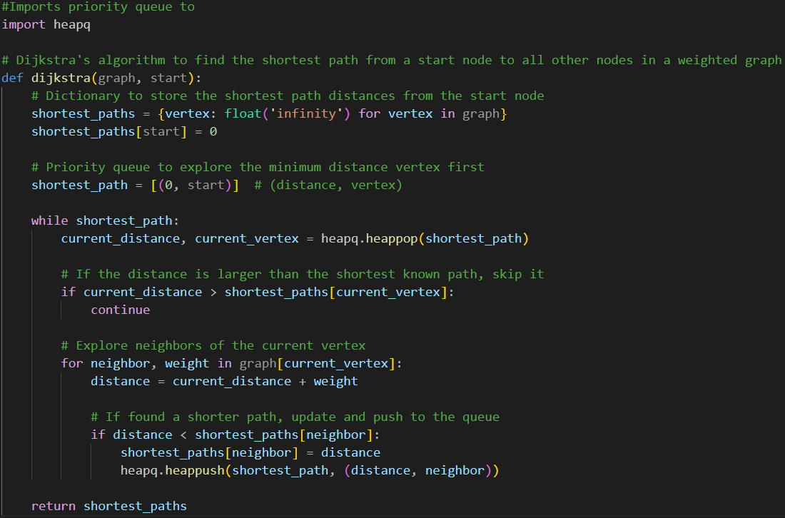
Concept:
Dijkstra's algorithm starts by setting initial distances for all vertices in the graph. It then chooses the unvisited vertex with the shortest distance from the starting vertex as the current vertex. The algorithm continues in this way, creating a tree of shortest paths from the starting vertex to all other points in the graph.
Implementation

Slide 7
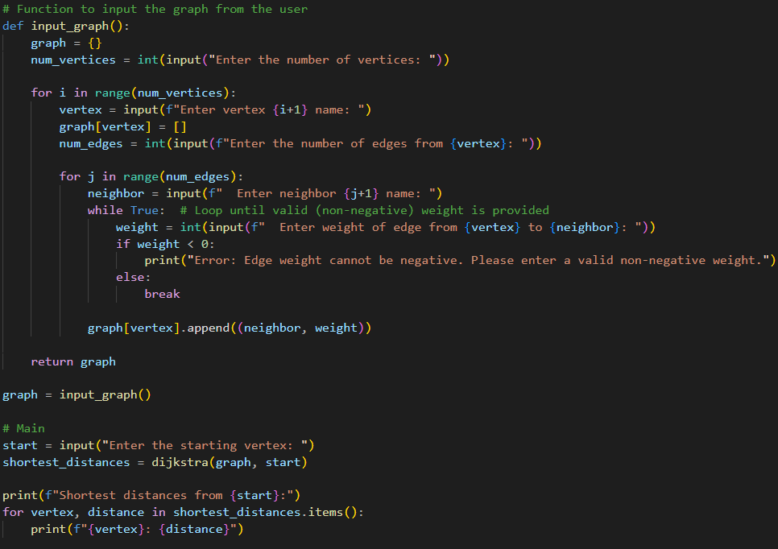
Concept:
Dijkstra's algorithm starts by setting initial distances for all vertices in the graph. It then chooses the unvisited vertex with the shortest distance from the starting vertex as the current vertex. The algorithm continues in this way, creating a tree of shortest paths from the starting vertex to all other points in the graph.
Implementation

Slide 8
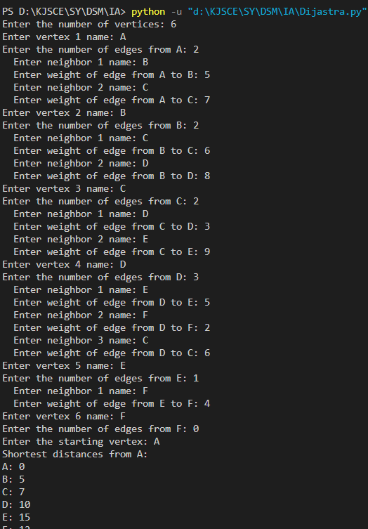
Concept:
Dijkstra's algorithm starts by setting initial distances for all vertices in the graph. It then chooses the unvisited vertex with the shortest distance from the starting vertex as the current vertex. The algorithm continues in this way, creating a tree of shortest paths from the starting vertex to all other points in the graph.
Output

Slide 9
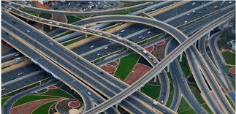


Concept:
Dijkstra's algorithm starts by setting initial distances for all vertices in the graph. It then chooses the unvisited vertex with the shortest distance from the starting vertex as the current vertex. The algorithm continues in this way, creating a tree of shortest paths from the starting vertex to all other points in the graph.
Applications
Network Routing: Dijkstra’s algorithm is widely used in routing protocols like OSPF (Open Shortest Path First) to find the shortest path between routers in a network. It ensures efficient packet delivery by determining optimal paths.
Geographical Information Systems (GIS): In mapping services such as Google Maps, Dijkstra’s algorithm is used to calculate the shortest driving or walking route between two locations.
Telecommunications: It helps in determining the most efficient path for data transmission in telecommunication networks, minimizing delays and improving the quality of service.
AI and Robotics: Dijkstra’s algorithm is used in pathfinding algorithms in robotics and AI to navigate agents through complex environments.

Slide 10
Concept:
Dijkstra's algorithm starts by setting initial distances for all vertices in the graph. It then chooses the unvisited vertex with the shortest distance from the starting vertex as the current vertex. The algorithm continues in this way, creating a tree of shortest paths from the starting vertex to all other points in the graph.
Thank You!

